Slide 1


Slide 2
Our Team (Group-6)
Sonam Singh
Neha
Karan Singh
Pooja Chavan
Prajakta Shelke
Abhishek Kumar

Slide 3
Table Of Contents
All KPI Insights & Business Decisions
What we learn
Challenges
Dashboard Screenshots

Slide 4
All KPI Analysis & Business Decisions

Slide 5
KPI-1 Year-wise Loan Amount Status

Slide 6
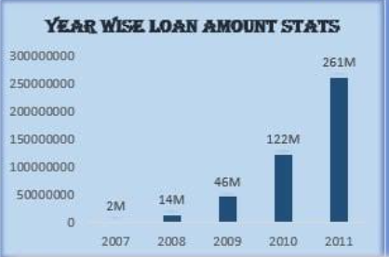
Insights
The total loan amount jumped from 2M to 261M during its steepest incline between 2007 and 2011.
Business Decision
Marketing and loan offers to customers from years with high loan amounts. Develop specialized loan products, engage customers, and adjust strategies based on seasonal trends for effective targeting and business growth.

Slide 7
KPI-2
Grade and Sub Grade wise Revol- balance

Slide 8
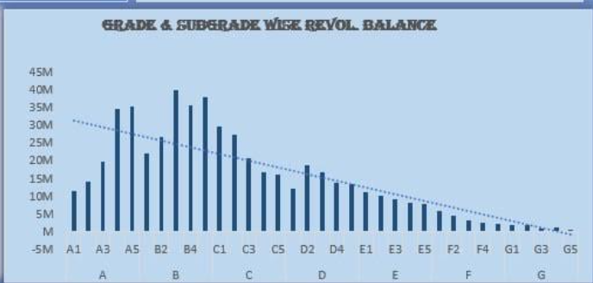
Insights
The total loan amount for Grade B is which is the highest among all grades
Overall it provides an understanding of the distribution of loan amounts across different risk-level categories.
Business Decision
Leverage this data to optimize risk assessment and customer engagement
Risk Management: Tailor risk evaluation based on revolving balances in different grade/sub-grade segments.
Customer Support: Engage customers with high revolving balances, providing guidance and personalized solutions.

Slide 9
KPI-3
Total Payment for Verified Vs Non-Verified Status

Slide 10
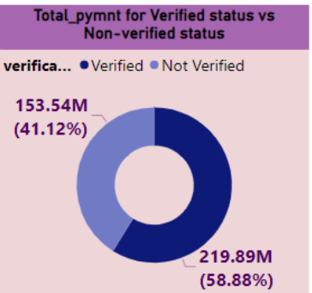
Insights
It compares total payments between "Verified" and "Not Verified" statuses, offering insight into payment behavior based on verification status.
Business Decision
Analyze, if verification status influences payment behavior. Verification processes, communication, risk assessment, and product offerings accordingly for enhanced customer engagement and risk management.

Slide 11
KPI-4
State-wise and last-credit-pull-d wise loan status

Slide 12
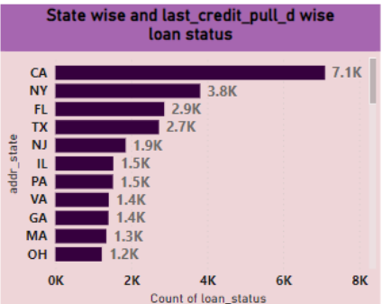
Insights
It shows loan status by state and last credit pull date, revealing regional loan performance patterns.
From this, we understand that California (CA) has the highest number of loans (7.1k) followed by New York(NY) with 3.8k loans. This indicates that these states have relatively higher demand of loans.
Business Decision
Bank can consider focusing their efforts on states with low loan counts to expand their customer base and increase their lending activities
For states with lower loan statistics, it's essential to explore the underlying factors contributing to this trend. such as offering specialized loan products, targeted marketing campaigns, or partnerships with local businesses and organizations to stimulate loan demand.

Slide 13
KPI-5
Home ownership Vs last payment date stats

Slide 14
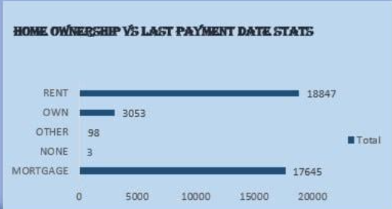
Insights
It explores payment patterns based on home ownership status and last payment dates.
As per the analysis mortgage has highest loan count.
Business Decision
Analyze payment behavior by home ownership to communicate, assess risk accurately, offer financial education, and customize products. Develop strategies for customer retention.
Collaborate with real estate agents, property managers, or landlords to establish referral programs. This can help reach potential customers within the real estate industry.

Slide 15
What do we learn ?

Slide 16
What we learn?
Importance of key performance indicators in data analysis.
Parameters to be assessed after loan distribution by banks e.g. home ownership, revolving balance, grades, verification status, etc
How all these parameters are extracted from data to make pivot tables, charts and interactive and mesmerizing dashboards in Excel, Power BI, and Tableau using slicers, filters, icons and images. Writing queries for same in SQL

Slide 17
Challenges

Slide 18
Challenges
True challenge was to assemble our classroom knowledge and to put it into this real-world situation.
Different opinions and priorities to be gathered as a team for each tasks.
Compiling and selecting the best outcomes for presentations .

Slide 19
Dashboard Screenshots

Slide 20
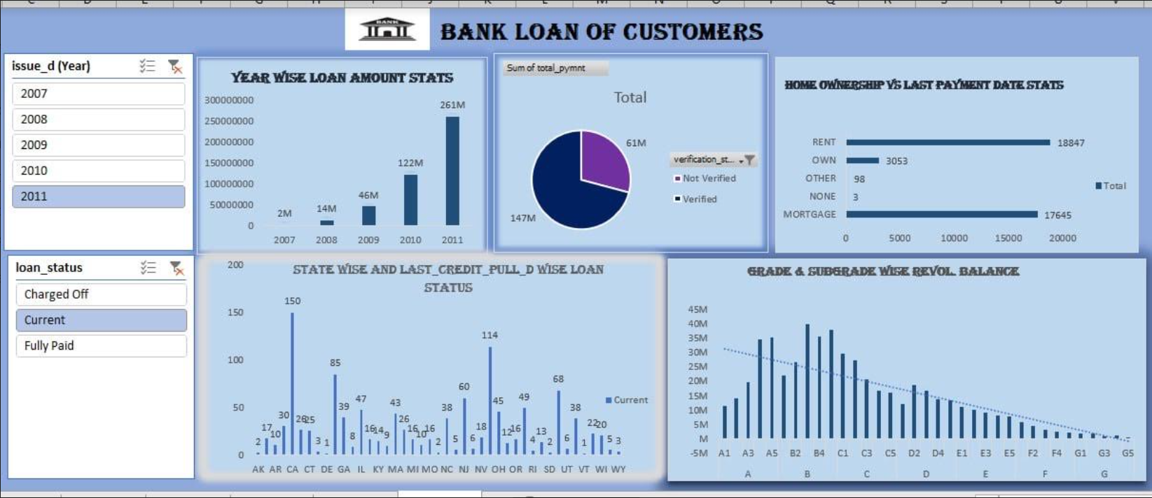
Excel Dashboard

Slide 21
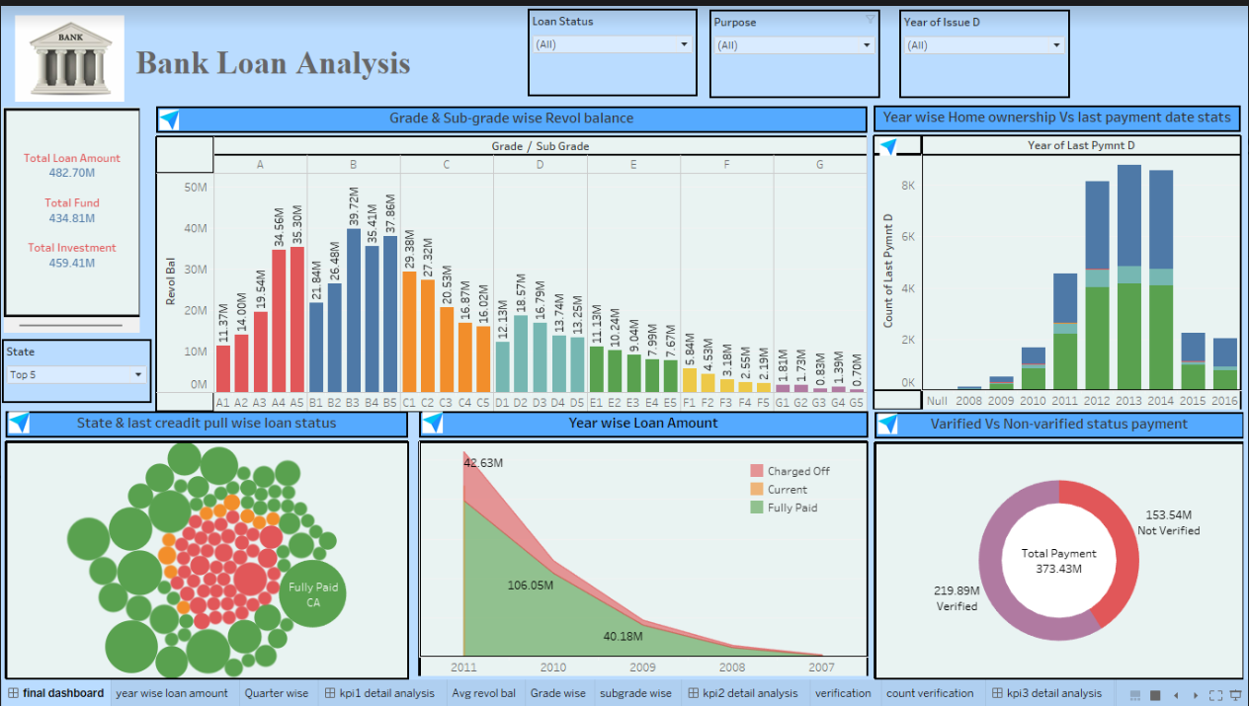
Tableau Dashboard

Slide 22
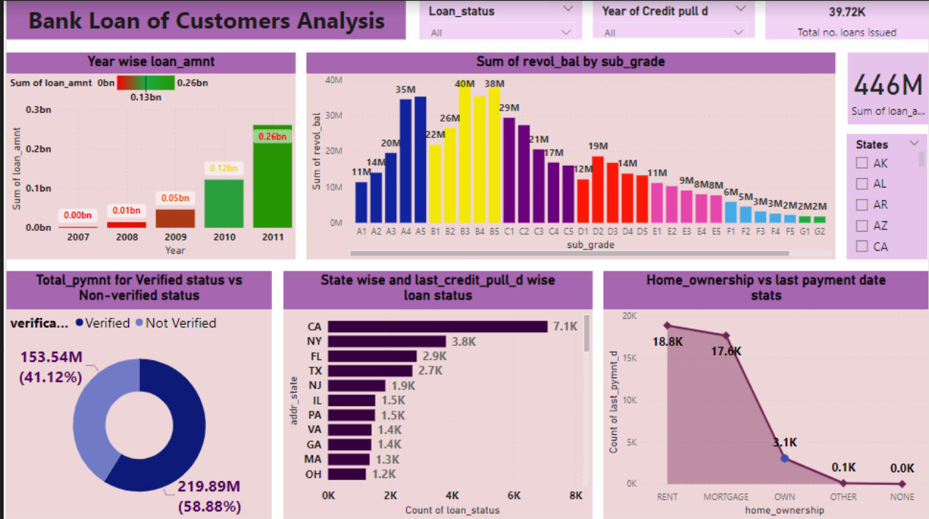
Power BI Dashboard

Slide 23
Conclusion
On the basis of various techniques applied for the financial analysis of Bank loan we can arrive to the conclusion that the financial position and overall performance of bank is satisfactory and loan amount and the customers of bank has increased over the period of time and bank has maintaining the profitability position.
This analysis will provide valuable information to a wide range of stakeholders, from banks and borrowers to investors, regulators, credit rating agencies, economists, and consumers.

Slide 24
Thank you

